Slide 1
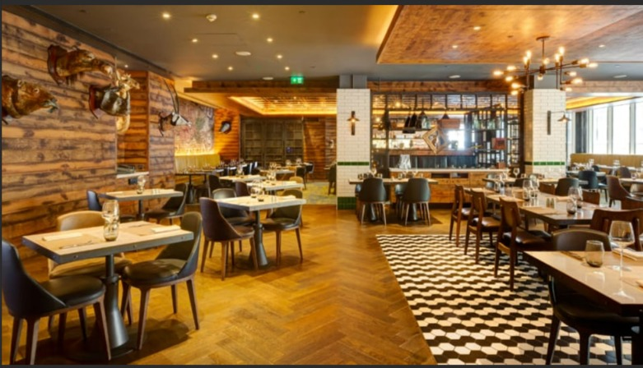
@MALLS "Africa's finest roots”

Slide 2

@MALLS is a celebrated local restaurant, famous for its authentic Southern African cuisine.
Experiencing a massive surge in popularity, leading to a high volume of daily bookings and takeaway orders.
The restaurant is quickly becoming a local hotspot, putting a strain on its current operations.
Current system: All orders and bookings are managed manually using paper logs and basic spreadsheets.

Slide 3

A busy restaurant with a chaotic atmosphere
Full tables with customers waiting.
Staff rushing to take orders and serve food.
Orders are getting mixed up Phone ringing constantly.
Manual entry leads to frequent errors & double bookings
Incorrect takeaway orders, and customer confusion.

Slide 4
Operational Challenges
- Order & Booking Mix-ups
Manual entry leads to frequent errors, double bookings, incorrect takeaway orders, and customer confusion.
- No Centralized Data
Struggling to track customer preferences, manage the loyalty program, or identify repeat guests effectively.
- Difficult to Scale
Hiring more staff to manage paper logs is costly and doesn't solve the root problem. The system is at its breaking point.

Slide 5
The Solution: A New Digital Front-Door
We have a simple, user-friendly website to streamline all customer interactions.
* An easy-to-browse digital menu.
* A simple form for dine-in reservations.
* A clear form for placing takeaway orders.
* A loyalty programme for our customers.
* A map for our customers find us quicker.

Slide 6
Digital Transformation for @MALLS Migrating to AWS for Growth & Efficiency
Scalability: AWS allows you to easily scale your website up or down to match changing traffic demands.
Reliability: AWS has a proven track record of uptime and availability, with multiple data centers worldwide.
Cost-effectiveness: AWS offers a pay-as-you-go pricing model, so you only pay for the resources you use.
Security: AWS provides robust security features, including encryption, firewalls, and access controls.

Slide 7
Amazon S3: Website Hosting
Static websites: S3 is a great fit for static websites, blogs, and portfolios.
Web applications: S3 can serve as a storage layer for web applications.
Content delivery: S3 integrates with CloudFront for fast content delivery.
S3 also acts as a highly durable and extremely low-cost "bucket" to store all restaurant images—menu photos, website graphics, and even promotional videos. All website assets are stored and served from one reliable source.

Slide 8
Proposed AWS Architecture
## A Simple, Powerful Architecture
1. A customer visits the **@malls.co.za** domain name.
2. **Amazon Route 53** (AWS's DNS service) directs the request to the correct location.
3. The website, all images, and all files are served directly from the **Amazon S3 bucket** configured for static website hosting.
4. **Future Upgrade:** We can easily add **Amazon CloudFront (CDN)** to make the website load instantly for customers anywhere in the world.
*(This slide would feature a simple diagram: [User] -> [Route 53] -> [S3 Bucket])*

Slide 9
Benefits of Choosing AWS
* **Incredibly Low Cost:** You only pay for the storage you use and the data transferred. For a static site, this is often just a few dollars a month.
* **High Reliability (11 Nines):** S3 is designed for 99.999999999% durability. Your website will always be available and your data is safe.
* **Massive Scalability:** Whether 10 customers or 10,000 visit your site during a promotion, S3 handles the traffic automatically. No crashes, no slowdowns.
* **Simplicity & Sustainability:** This is a "serverless" solution. No servers to patch or manage, reducing complexity and energy consumption.

Slide 10
Cost Analysis: On-Premises vs. AWS
# $$$ - High Upfront & Sunk Cost
Traditional hosting requires buying a physical server, paying for power, cooling, and maintenance, and over-provisioning for peak traffic you might not even use.
# $ - Pay-As-You-Go
With S3, there's **$0 upfront cost**. You pay pennies per GB for storage. The AWS Free Tier will likely cover all hosting costs for the first year, making it free to start.

Slide 11
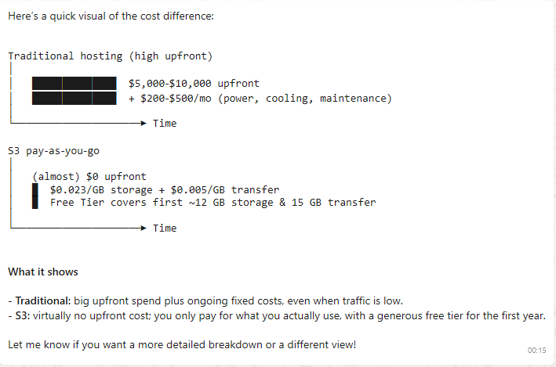

Slide 12
Questions & Answers?
Thank you!!
@MALLS & AWS re/Start

